Slide 1
Introduction to Software Business Product management
Week 1 Day 2
Led by: Emily Crose
for
Oakland University

Slide 2

Day 1 recap

Slide 3

Question or clarifications?

Slide 4
What is programming?
Notes:
Programming is our ability to give a computer a set of tasks that it can execute.

Slide 5
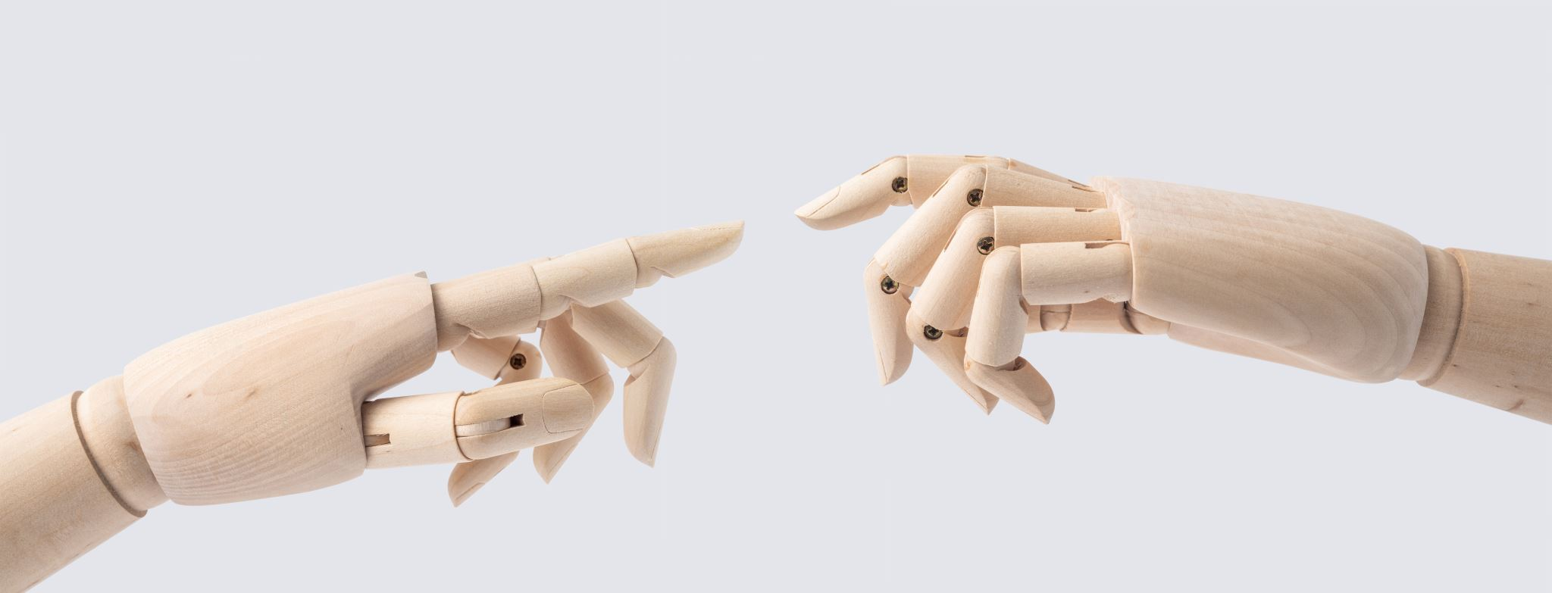
Manual vs. automation
Notes:
How do we decide when we need to automate something?

Slide 6
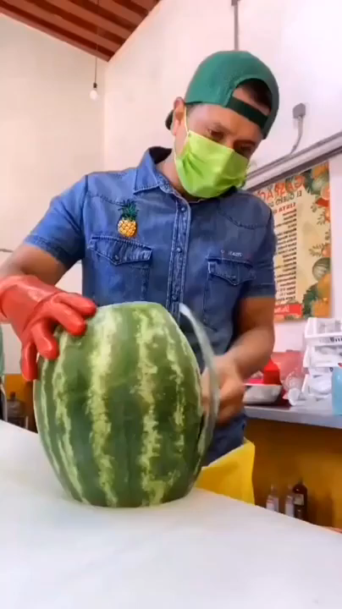
Notes:
In the world of computers, you can choose to do any given task one of two ways mainly. You can do things manually, and that might work just fine if all you need to do is a single task a single time. But at scale, it doesn’t matter how good you are at executing that task. At a certain point, automation will always make more sense.

Slide 7
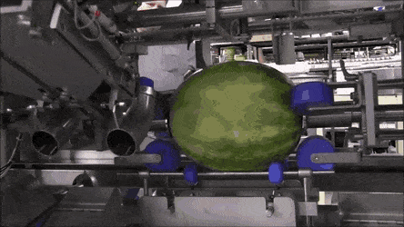

Slide 8

Process flowchart
Notes:
We can also use flowcharts as a tool to outline the way that information is generated and processed by a system. Using tools like pseudocode and flowcharts can help build an idea of exactly how the program will do what it’s supposed to do.

Slide 9

“Pseudo”code
Notes:
The exercise of producing “pseudocode” can help solidify concepts into achievable actions which can be programmed and build as an application.

Slide 10
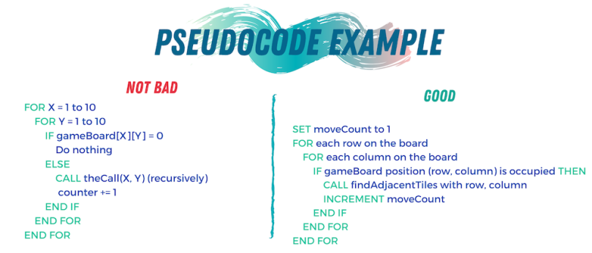
Pseudocode example

Slide 11
Loops

Slide 12
If/Then loops

Slide 13
For loops

Slide 14
While loops

Slide 15
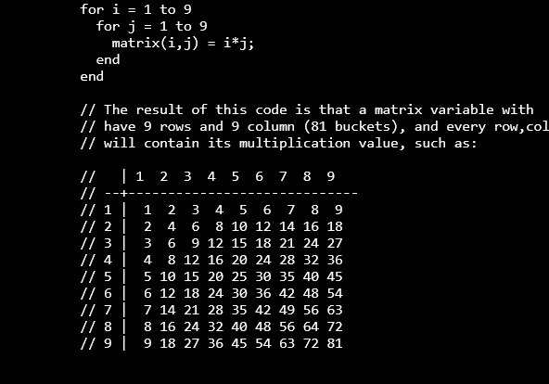
Nested Loops

Slide 16
Case statements

Slide 17
How Does an App get made?

Slide 18

Modern software development concepts
Notes:
Today, we’re going to talk at a high level about how modern software is imagined, developed and delivered. We will get into more specifics on this process when we examine the Software Development Life Cycle, but for now, let’s try to visualize exactly how software construction works.

Slide 19

Why would we make an app?
Notes:
You may be wondering why we would want to use software at all to solve any of our problems. The modern world has turned to software largely because of how versatile it is at solving modern problems. It’s not just about entertainment, it’s about letting technology reduce human toil.

Slide 20

How do we build a quality app?

Slide 21

What is the problem?
What problems does this app solve?
How does it solve these problems?

Slide 22

syntheszing a solution
Notes:
We will need to synthesize the solutions we’ve come up with into an app.

Slide 23
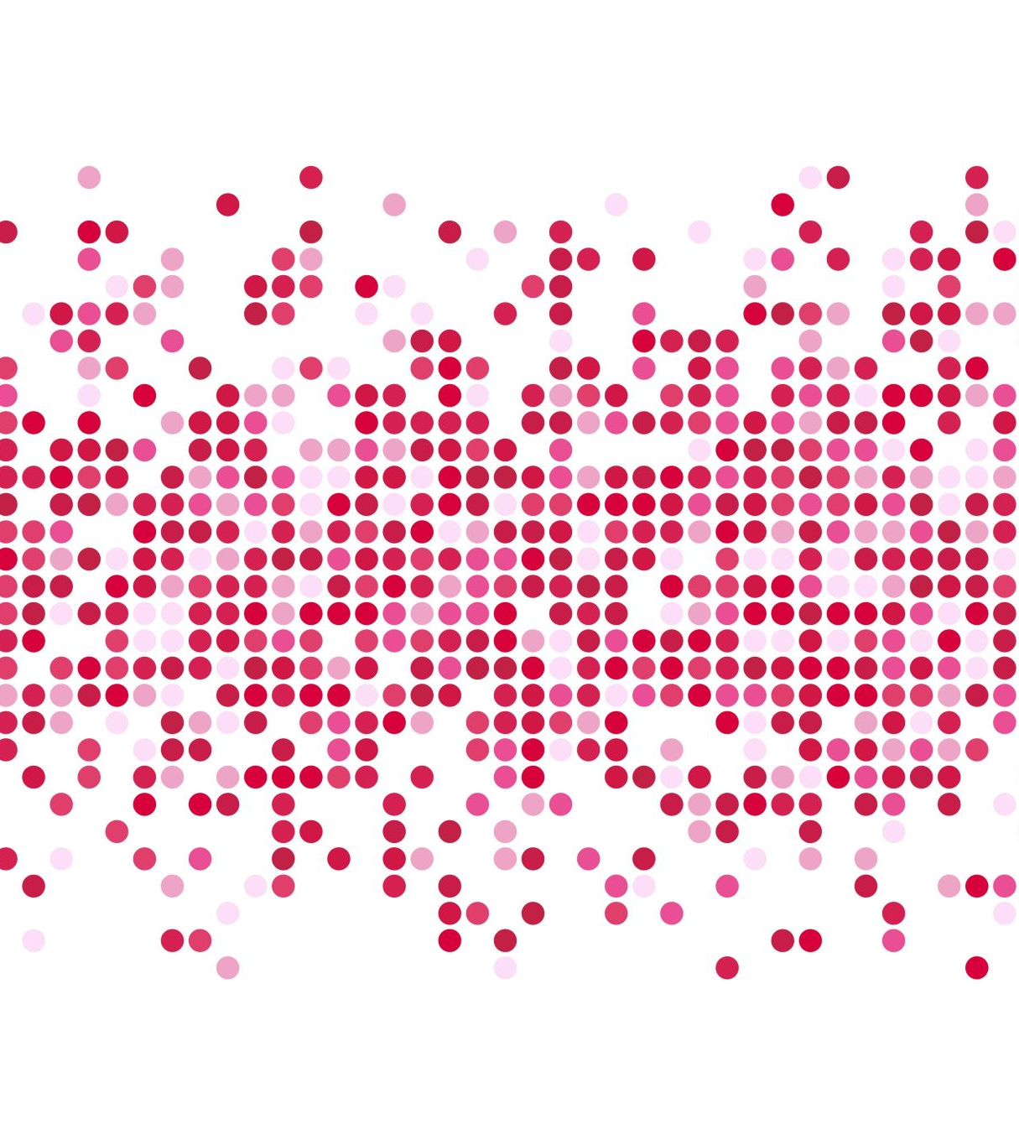
Generating requirements

Slide 24

Who makes software?
Notes:
To make modern software, it takes teams of people. It used to be the case that one rockstar developer could build and market an entire app all on their own. Applications today typically take a lot more people to make a successful application.

Slide 25

Leaders & managers
Notes:
Like any other project, there are leaders and managers involved in the process of creating an application. Generally speaking, project leadership make high level design decisions about how an application should function. This of course is only a small part of the puzzle.

Slide 26

Developers
Notes:
Developers are the lifeblood of executing program design. So when a design choice is made, how that choice gets implemented into the application is passed onto the developers. The “devs” then find the best way of putting the new feature into the program.

Slide 27

Separation of duties
Notes:
Separation of duties are important for defining exactly how and where processing happens. We will talk more about this topic when we get deeper into technical explanations, but for now, we should be aware that the specifics of how we process information is important.

Slide 28
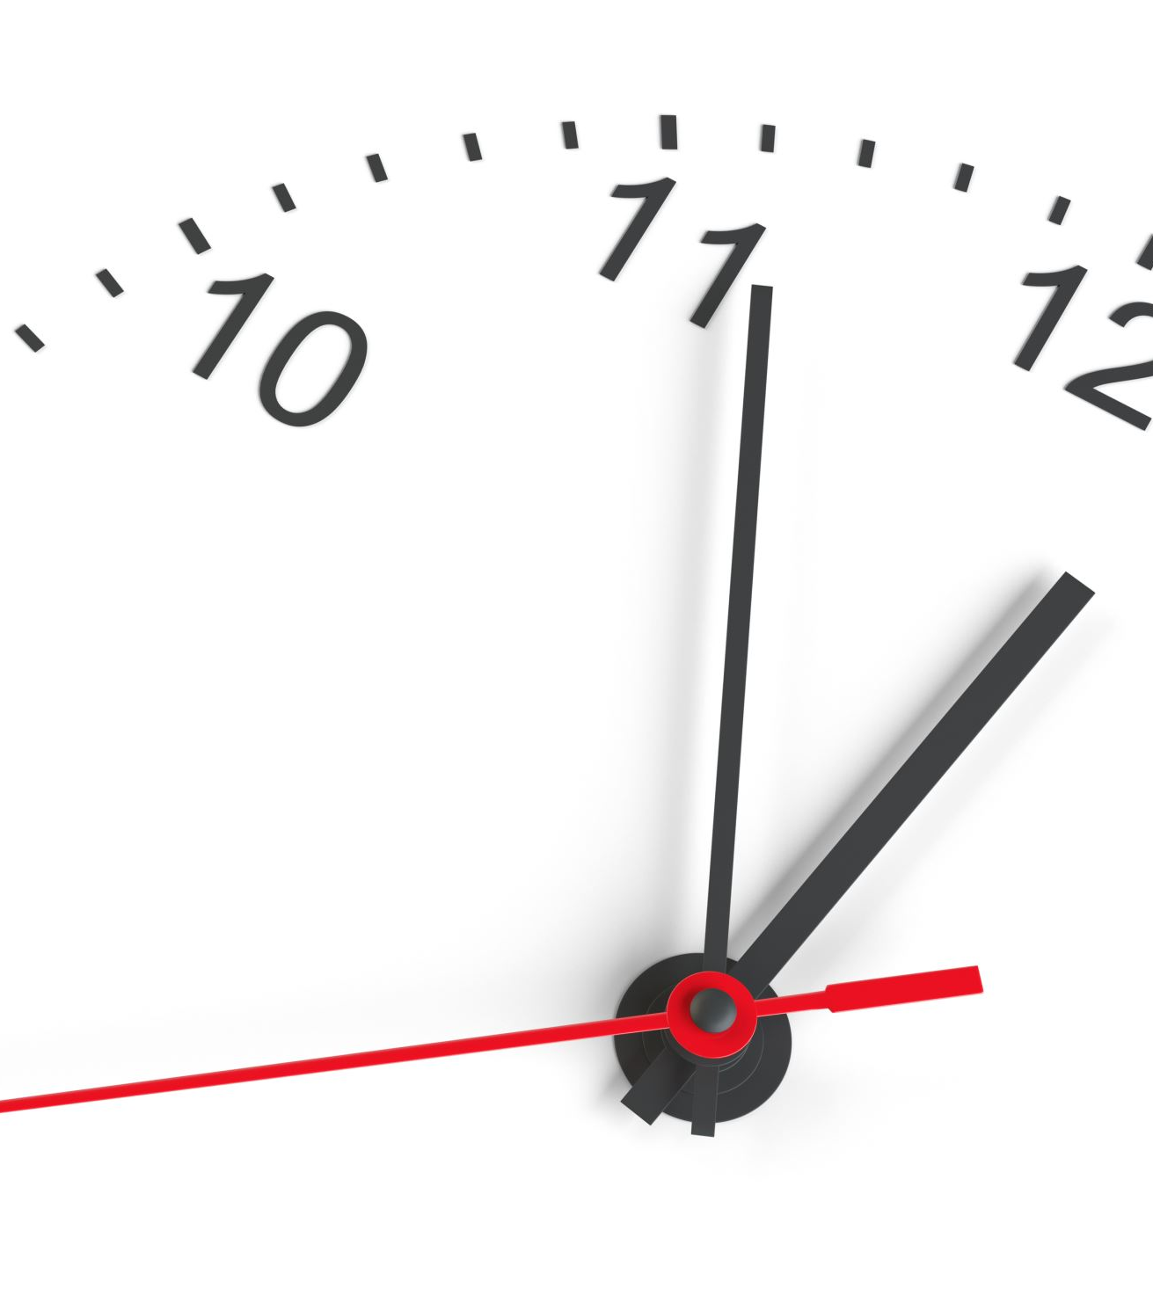
10 minute break

Slide 29

Testing
Does the code work as expected?
Does the code solve the problem we identified?
What does the code work on?
Does the code function with all of our supported systems?
Do we even know what possible systems exist in the field?
Notes:
When we do our testing, we need to ask a few questions about the app’s functionality.

Slide 30
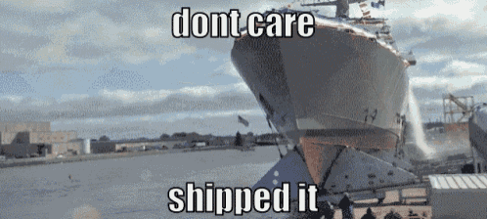
Code distribution

Slide 31
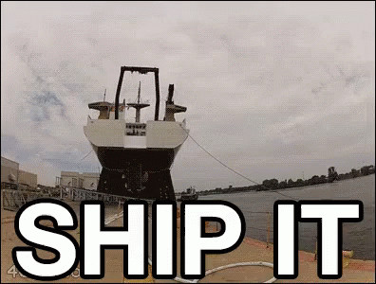
Problem discovery
Notes:
What happens if we discover a problem after we ship the code? What are our options?

Slide 32
Who are our users?
Do we know who they are?
What kind of sensitive information might we be processing?
Personally identifiable information?
HIPAA information?
Legally sensitive?
Notes:
Who are our users? What do they care about? Is there any sensitive information we may be processing that we need to take into account?
Is there a chance that we will run into unforeseen legal governance that will complicate either the way that we process information or store that information.

Slide 33
Supporting those customers
How do our customers contact us?
How do we contact them?
Do we have field support?
What is our process for addressing customer concerns/complains?
What is our process for addressing customer feature requests?
Ticketing system?

Slide 34

Questions?

Slide 35

Review Day 2

Slide 36

Preview day 3

